Slide 1
Bangla Parts of Speech Tagger
Supervised by
Md. Ruhul Amin
Lecturer
CSE,SUST
Presented by
MD.SOHEL AHMED 2006331034
S. M. NUSAYER HASSAN 2006331048
IMRAN ZAHID 2006331096

Slide 2
What is Parts of Speech Tagging?
Parts of speech tagging is a process where each word in a sentence is tagged with appropriate parts of speech for that word. This is also called as grammatical tag.
widely used for natural language processing

Slide 3
Why Parts of Speech Tagging?
Parts of Speech Tagging is mostly used in
Bangla Search Engine
Bangla Spell Checker
Bangla to English Translation
Bangla Text to speech

Slide 4
Common approaches of POS tagging
Two common approaches for parts of
speech tagging is
• Supervised pos tagging
• Unsupervised pos tagging

Slide 5
Brills tagger
Initialisation
Known words tag from corpus
Unknown words out of corpus
Learning or guessing rules with lexical rules
Learning Phase
Iteratively compute the error score of each candidate rule (difference between the number of errors before and after applying the rule)
Select the best (higher score) rule.
Add it to the rule set and apply it to the text.
Repeat until no rule has a score above a given threshold

Slide 6
Bangla Corpus
A corpus (plural corpora) or text corpus is a large and structured set of texts. Corpus is considered as basic resource for language analysis and research.
Bangla language analysis and research work it is necessary to have a complete Bangla linguistic corpus.

Slide 7
Existing work
In India research team from IITKP is working on POS tagging for bangla language. They developed a system which they called as a Hybrid tagging model. They claim for 95% accuracy for tagging.
In Bangladesh research team from Center for Research on Bangla Language Processing (CRBLP) did some work on bangla parts of speech tagging. Some work based on Maximum entropy markov model from Brac University has been done, but the result is not quite satisfactory.

Slide 8
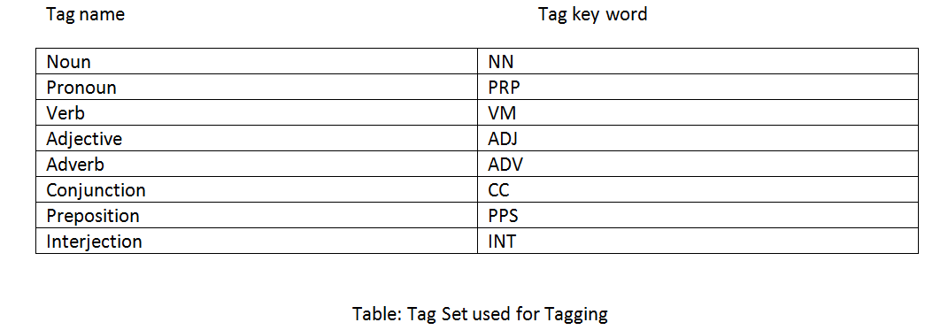
Tag Set

Slide 9
Stemming
It is a process by which we can reduce a part of a word to get the stem, base or root.
It takes us to origin of a word
Example-
Stemming/stemmed/stemmer -> Stem
Working/working/works -> Work

Slide 10
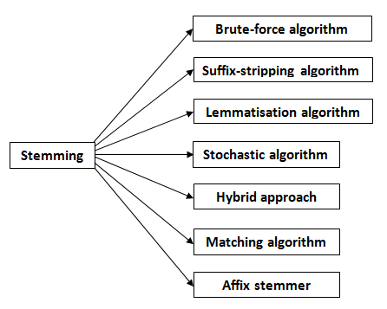
Several stemming algorithm

Slide 11
Prefix
A prefix is an affix which is placed before the stem of a word. Particularly in the study of Semitic languages, a prefix is also called a preformative, because it alters the form of the words to which it is affixed.

Slide 12
Suffix
In linguistics, a suffix (also sometimes called a postfix or ending) is an affix which is placed after the stem of a word. Common examples are case endings, which indicate the grammatical case of nouns or adjectives, and verb endings, which form the conjugation of verbs.

Slide 13
Bengali stemmer
In the field of English stemmer most successful work has been done.
But in the field of Bengali still it is in the research level.
In Bengali language a word can be stemmed by removing affixes (suffixes or prefixes)
Usually those modifiers are Bivokti, Kal, Protyoi, Uposhorgo and Sondhi.
Here the Uposhorgo is the prefix and rest of modifiers is suffixes.

Slide 14
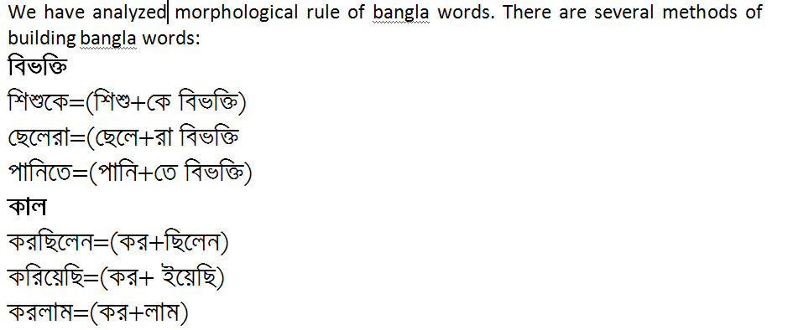
How Bangla words build

Slide 15
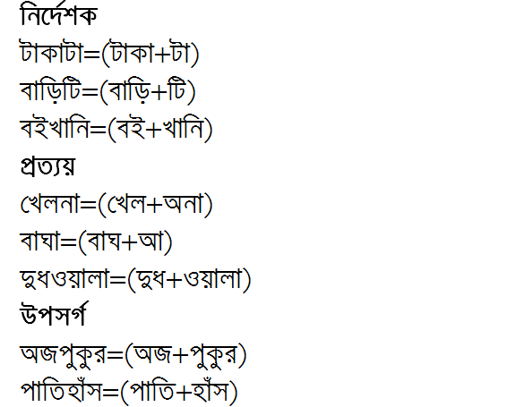
How Bangla words build

Slide 16
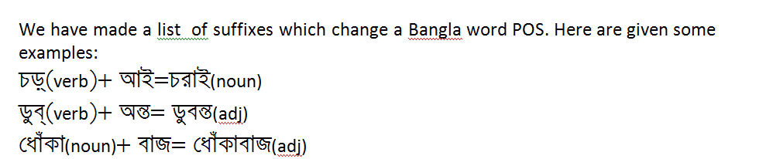
Some examples of Suffixes which change a Bangla word POS

Slide 17
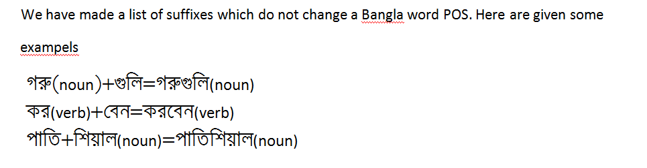
Some examples of Suffixes which do not change a Bangla word POS

Slide 18
Rules
We have made some rules for stemming which is stored in a rule file.Here are given some examples of rules:
ে bivokti unchanged isnoun noun
য় bivokti unchanged isnoun noun
তে bivokti unchanged isnoun noun
া lingo unchanged isadj adj
ী lingo unchanged isadj adj
ি kal unchanged isverb verb
ে kal unchanged isverb verb
েছিলাম kal unchanged isverb verb
িয়া prottoy changed isverb adj
িয়ে prottoy changed isverb adj
িষ্ণু prottoy changed isverb adj
ি prottoy changed isadj adj

Slide 19
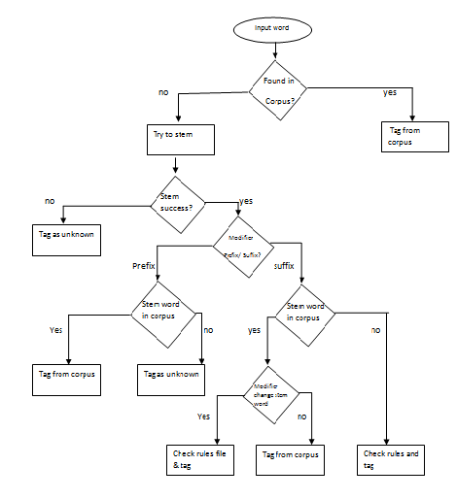

Slide 20
Pseudo code for stemming procedure
If(input word found in corpus)
{
Tag from corpus;
}
Else
{
Stem();
If(stem() return false)
{
Tag unknown;
}
Else
{
If(modifier==prefix)
{
If(stem word found in corpus)
{
Tag from corpus
}
Else
{
Tag unknown;
}

Slide 21
Pseudo code for stemming procedure
Else
{
If(stem word found in corpus)
{
If(modifier change stem word)
{
Check rule file and tag;
}
Else
{
Tag from corpus;
}
}
Else
{
Check rules and tag;
}
}
}
}

Slide 22
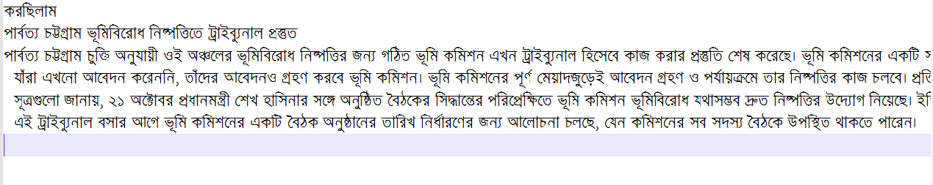
Input

Slide 23
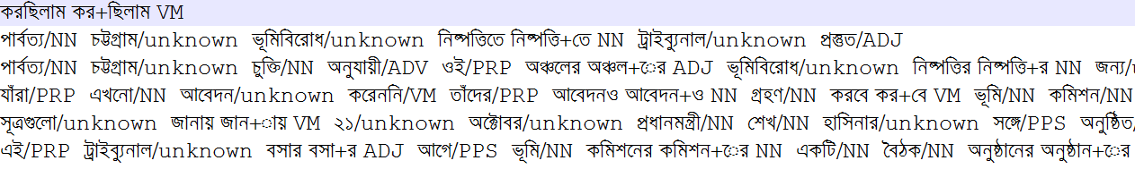
Output

Slide 24
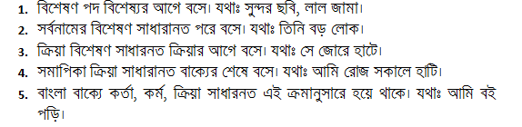
Some Syntax Rules of Bangla Sentence:

Slide 25
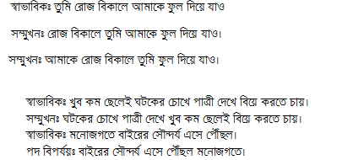
Exceptional:

Slide 26
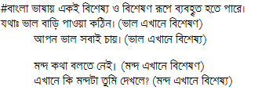
Exceptional:

Slide 27
Some example of Bangla Sentences’ Chain
NN+CC+NN+CC+CC+CC+NN+VM+NN+
NNL+NN+NNL+CC+NNL+NN+
ADJ+NN+NN+CC+NN+ADJ+VM+ADV+NN+ADV+NN+ADJ+VM+VM+ADJ+NN+PRP+NN
For tagging unknown words we are proposing that in a chain file all chain rules will have to store. Then the system will have to match the input sentence with the Chain file. The unknown word which is most familiar with the chain rule will have to tag.

Slide 28
Conclusion
Our junior batch is now working on POS Tagging Chain rules. We will share our knowledge with them & we think it will be a efficient POS tagger.

Slide 29
Referene
1.” A simple Rule based parts of speech tagger” by Eric Brill
2. ”A hybrid model for Parts of speech tagging and its application in Bengali” by
Sandipan dandapat, Sudeshna sarkar and anupam basu.
3. “Syntactic parts of speech tagging guideline for bangla text” by Altaf Mahmud and
Mumit khan.
4. “Brown corpus” by henry Kucera and nelson francis.
5.Barnan Das & Tanmoy Pal, Development of Bengali Language Stemmer 2009,
Indian Institute of Technology, Kharagpur.
6.Morphological Stemming Cluster Identification for Bangla, Jadavpur University.
7.Porter Stemmer Algorithm,1980.
8.বাংলা ভাষার ব্যকরণ-মুনীর চৌধুরী,মোফাজ্জল হায়দার চৌধুরী
9.বাক্যতত্ত্ব-হুমায়ুন আজাদ
10.”Research Report on Bangla Verb and Noun Morphological analysis” by Md.Zahurul Islam, Center for Research on Bangla Language Processing (CRBLP),BRAC University.

